Slide 1
HEVC Codec IP Review
Jialiang Liu / Xing Yuan
2017-11-15

Slide 2
Contents
IP Features
Block Diagram
Key internal modules
Interfaces
Performance & Target Perf.
Sign Off
Buffers and BW
Program & Workflow
Codec System Delay
Key Features

Slide 3
Feature
HEVC Encoder
Main/Main10 Profile @ L5.0 High Tier
8bit/10bit sample precision
Max Performance:
4K@30fps @ 400MHz
Max Resolution: 8192x4096
CBR, ABR, VBR rate control
I/P/B frame types
Flexible GOP setting( 8 kinds of GOP structure )
ROI / QP Mapping / Mode Mapping
Noise Reduction
Sub-FrameSync (low delay tool)
Intra-Refresh (low delay tool )
Reference Compression
High Complicated RDO
YUV 420/422
HEVC Tools
CU Size: 64x64, 32x32, 16x16, 8x8
PU Size: 32x32, 16x16, 8x8
TU Size: 32x32, 16x16, 8x8, 4x4
Deblocking/SAO
WPP/ MultiSlice
Lossless Coding
Transform skip
Search Range: [+/-128H, +/-64]

Slide 4
Feature
HEVC Decoder
Compatible with HEVC Main/Main10 @ L5.0 Main-tier
High Performance CABAC
Reference Compression
Robust Error Concealment

Slide 5
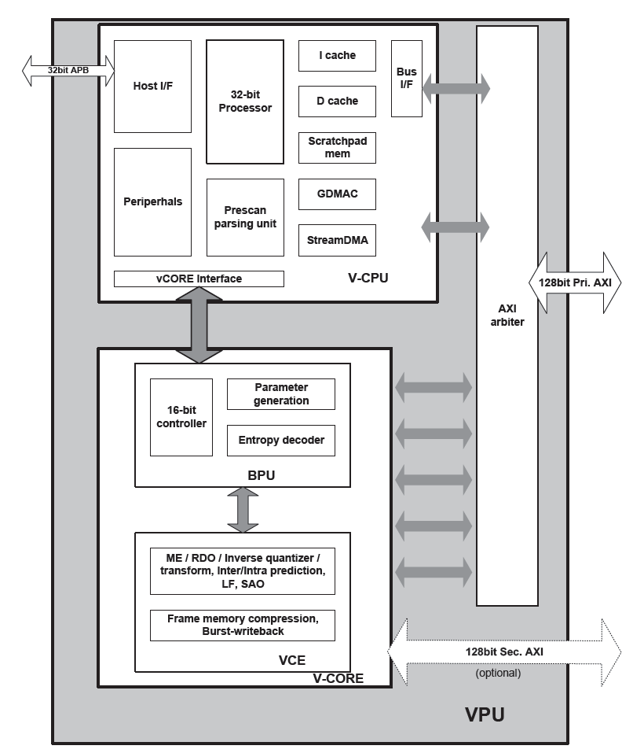
Block Diagram
Key Internal Modules
V-CPU
32bit processor
Enc/dec high level syntax-SPS /PPS/SH
Communicate with Host
Give params/info to V-Core
V-Core
BPU
Packing/parsing of coded slice data
Cabac
CTU/CU/PU/TU-level parameter derivation
VCE
ME/RDO/T/Q/IT/IQ/LF/SAO/FBC/FBD/BWB

Slide 6
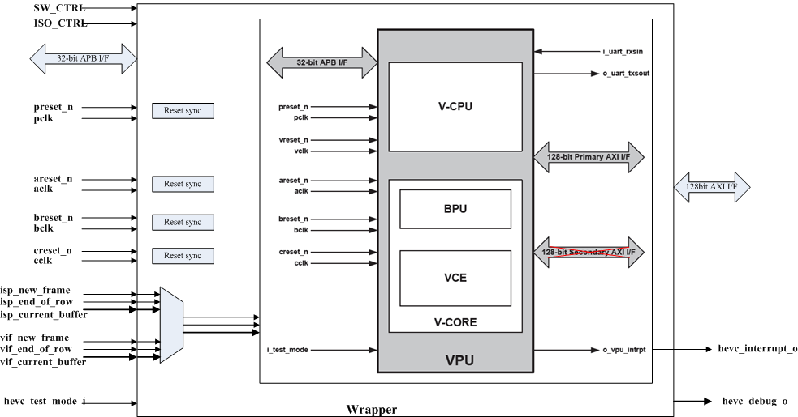
Block Diagram
Interfaces
Interrupt
Idle
AXI Bus
APB Bus
Low delay
power control

Slide 7
Performance Requirement
3840x2160@30fps + 1080P@30fps @ 550MHz ( with 50Mhz margin)
Encoder ( cclk @ bclk 333MHz ) |  | Decoder ( cclk @ bclk 333MHz)
4K @ 30 fps, IPPP, 8bit | 400 MHz, (no margin) | 4K @ 30fps, IPPP, 8bit | 300MHz (no margin)
4K @ 30 fps, IBBB, 8bit | 410 MHz, (no margin) | 4K @ 30fps, IBBB, 8bit | <400MHz (estimated)
4K @ 30 fps, IPPP, 10bit | 410 MHz, (no margin) | 4K @ 30fps, IPPP, 10bit | 300MHz( no margin )
4K @ 30fps, IBBB, 10 bit | 410 MHz, (no margin) | 4K @ 30fps, IBBB, 10bit | <400MHz( estimated)
Cabac (Encoder) ( bclk ) | Cabac(Decoder) ( bclk )
~ 2 bin / cycle (500Mbps @ bclk 333MHz, cclk 410MHz) | ?(未统计)

Slide 8
SignOff
Area
PR Area | 6,724,870
DC Area | 3,905,299
Memory Area | 1,367,114
Instance | 3,035,098
Memory Size | 3,367,584(bit)
Corner
7T, SVT,C35
ssgwc0p81vn40c
Constraints
30% clock uncertainty
Power Domain
Frequency
PCLK | 150MHz
BCLK | 300MHz
CCLK | 360MHz
ACLK | 360MHz

Slide 9
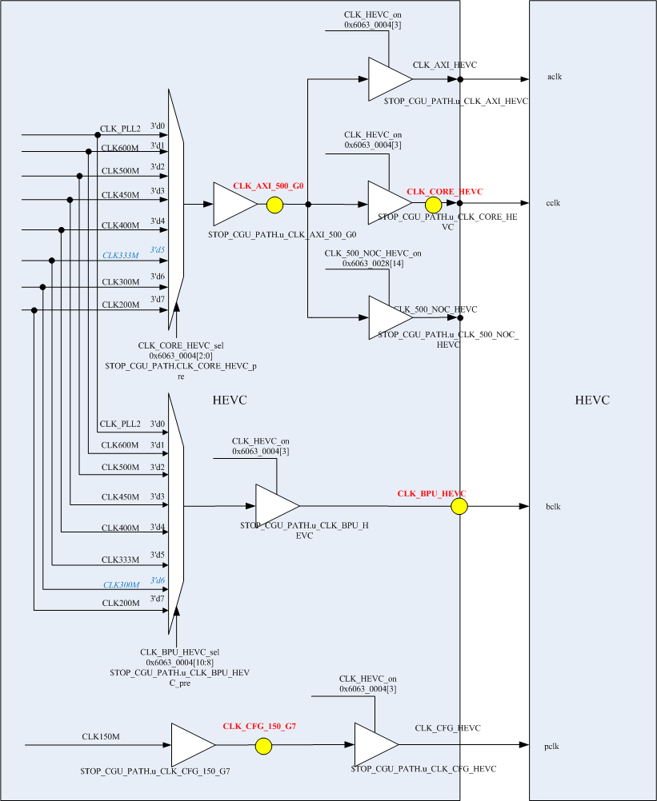
SignOff
Clocks
4 Clock domains
CLK_AXI_500_G0 / CLK_CORE_HEVC/ CLK_BPU_HEVC / CLK_CFG_150_G7
False path between each other
CCLK and ACLK are one clock source

Slide 10
Buffers in DDR
Code Buf : 1 for all instances
V-CPU running code
Work Buf : 1 for each instance
Stores the information during encoding/decoding process. ?
Temp Buf : 1 for each instance
Top line for IP, Top line for Debloking, Neighbor infor for RDO, and CABAC
Size: 128KBtye for Enc, 3MByte for Dec
Bit stream Buf:
Frame Buf:
Uncompressed ( linear )
Compressed
Collocated MV:
Subsample Frame:
For IME

Slide 11
BandWidth
4K @ 30fps Encoding, 3P/4B for 10bit
4K @ 30fps Decoding, 3P/4B for 10bit
Decoder BW < Encoder BW
Frame Type | 8bit | 10 bit
P | 900MBps | 1350MBps
B | 1170MBps | 1740MBps

Slide 12
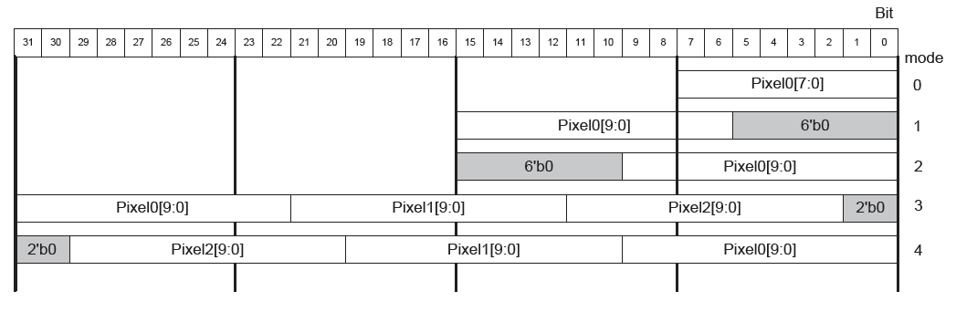
FB Format
Pixel Layout
0: 8bit mode
1: 16bit mode, LSB padding
2: 16bit mode, MSB padding
3: 32bit mode, LSB padding
4: 32bit mode, MSB padding
Frame Layout
Source Image
8 bit/ 10 bit
YUV420/YUV422 ( down sample to YUV420 internally )
Planar, Semi-planar, Compressed (CF50)
Rec Image
8 bit/ 10 bit
YUV420
Planar, Semi-planar, Compressed (CF100)

Slide 13
FB Format Requirement for ISP/VIF
For ISP/VIF
Mode | Bit depth | Pixel Format | Layout on 128bit bus | Layout on DDR | YUV | For IP | 主路 | 从1 | 从2
1 | 8 | 1B/1P | [MSB] P15 … P2 P1 P0[LSB] | Planar | YUV420 | HEVC/H264/JPEG/Display | √ | √ | √
2 | 8 | 1B/1P | [MSB] P15 … P2 P1 P0[LSB] | Planar | YUV422 | JPEG | √ | √ | √
3 | 8 | 1B/1P | [MSB] P15 … P2 P1 P0[LSB] | Planar | YUV444 | JPEG | √ | N | N
4 | 8 | 1B/1P | [MSB] P15 … P2 P1 P0[LSB] | Semi-planar | YUV422 | Display | √ | N | N
5 | 8 | 1B/1P | [MSB] P0 P1 P2 … P15[LSB] | Planar | YUV420 | CF50 | √ | N | N
6 | 10 | 4B/3P（ Valid bits in LSB ） | [MSB] P11 … P2 P1 P0[LSB] | Semi-planar | YUV420 | HEVC/Display(w/o scalling/mirror/rotation) | √ | N | N
7 | 10 | 4B/3P（ Valid bits in LSB ） | [MSB] P11 … P2 P1 P0[LSB] | Semi-planar | YUV422 | Display | √ | N | N
8 | 10 | 2B/1P ( Valid bits in MSB ) | [MSB] P7 … P2 P1 P0[LSB] | Semi-planar | YUV420 | Display( w Scaling/mirror/rotation) / Jpeg for 12bit encoding / HEVC | √ | N | N
9 | 10 | 2B/1P ( Valid bits in MSB ) | [MSB] P7 … P2 P1 P0[LSB] | Semi-planar | YUV422 | Jpeg for 12bit encoding / HEVC | √ | N | N
10 | 10 | 2B/1P ( Valid bits in MSB ) | [MSB] P7 … P2 P1 P0[LSB] | Semi-planar | YUV444 | JPEG for 12bit encoding | √ | N | N
11 | 10 | 2B/1P ( Valid bits in LSB ) | [MSB] P0 P1 P2 … P7 [LSB] | Planar | YUV420 | CF50 | √ | N | N

Slide 14
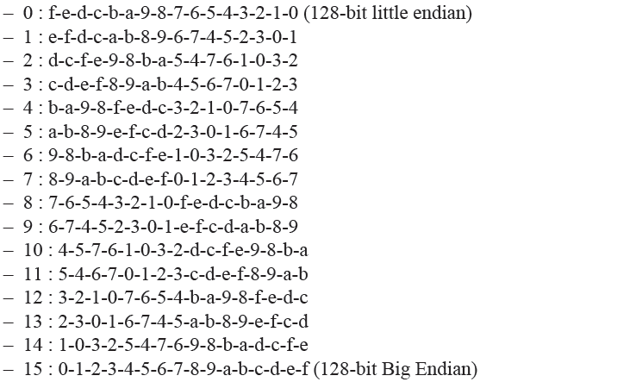
Endian
Only LITTLE endian is required in Sirius.
16 endian modes

Slide 15
AXI Bus
Two axi buses
Pri-AXI
Access Code Buf, Work Buf, Frame Buf, BitStream Buf, and the bufs except Temp buf.
Sec-AXI
Optional, to access on chip sram
Temp Buf
AXI requests efficiency to DDR
Refer to <LeiYu.ppt>

Slide 16
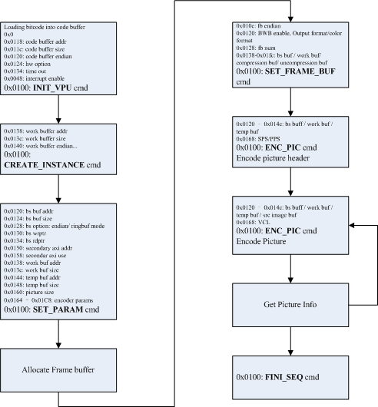
Program & Workflow
Encoding Flow

Slide 17
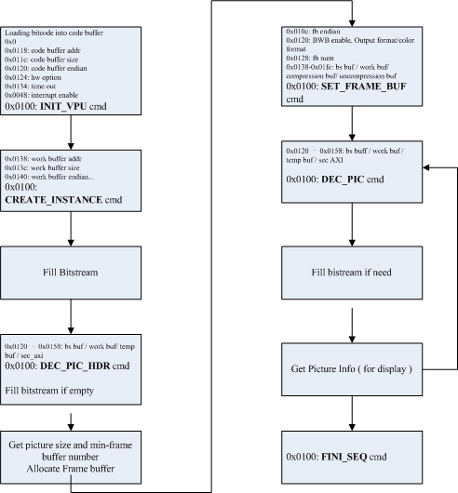
Program & Workflow
Decoding flow

Slide 18
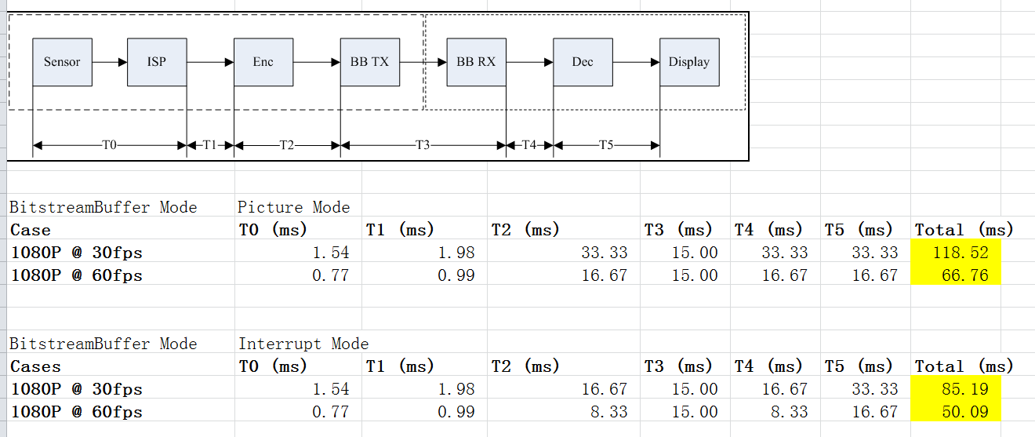
Codec System Delay
Issue:
Can NOT generate interrupt signal ½ or 1/N picture encoding.

Slide 19
Quality Evaluation
HEVC vs H264

Slide 21
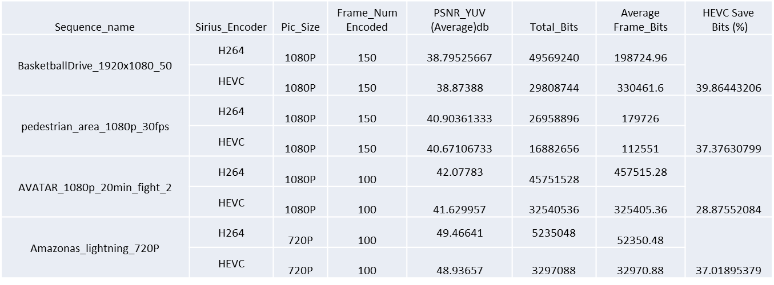
Quality summary

Slide 22
Key Features
Low-delay encoding
Signal: i_ipu_new_frame, i_ipu_end_of_row, i_ipu_current_buff[2:0]

Slide 23
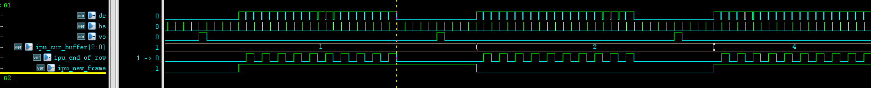
Low_delay Timing

Slide 24
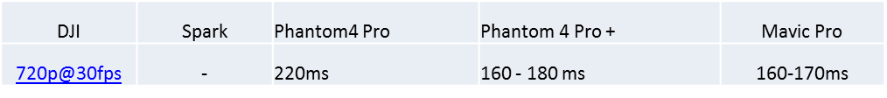
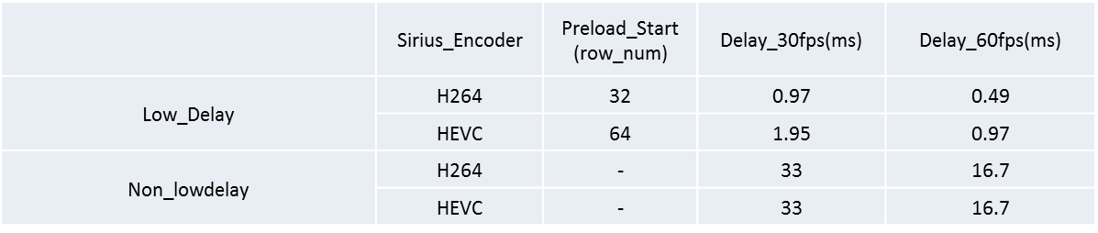
Bitstream Transfer with Baseband
1. DJI Products
2. Timing save

Slide 25
Key Features
Intra Refresh
Enabled in non-intra picture
For error robustness

Slide 26
Recovery scheme

Slide 27
Intra Refresh Config
Register
1> Intra_Refresh_Mode, 2bits
0– No intra Refresh ; 1- Row ; 2- Column ; 3- step size in CTU
2> Intra_Refresh_Arg, 16bits
num consecutive CUT Rows in Mode 1 ;
num consecutive CUT Columns in Mode2 ;
Step size in CTU for Mode3

Slide 28
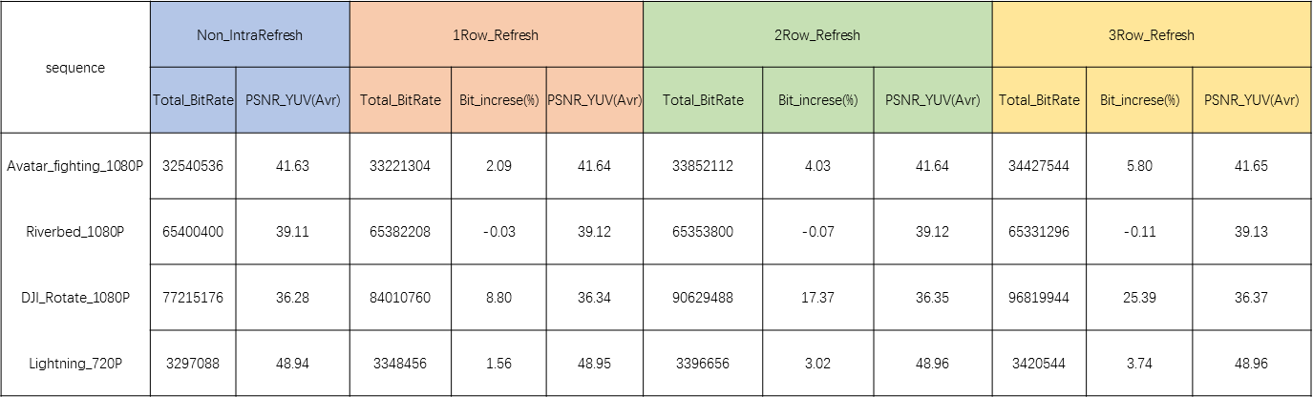
Image quality with Intra Refresh

Slide 29
Key Features
Noise reduction
(noise reduction是怎么回事儿）
质量如何？
DuHua and Hikvision smart H265+
Sirius HEVC encoder ?

Slide 30
End
Thanks
Q&A

